Slide 1

Clothing Shop
Software Engineeing

Slide 2
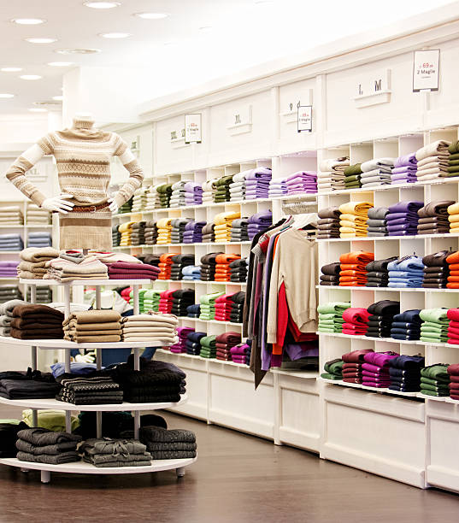


Agenda
INTRODUCTION
DIGRAMS
FRAMS
SUMMARY

Slide 3
Dr/ Shaimaa Talaat
team members
Adham Ashraf Ibrahim
Ahmed Mohamed said
Ahmed Adel Hassan
Ayat Ashraf Mohamed
Aya Abdelnaby Abdelraoof
Hanan Yasser Ibrahim

Slide 4
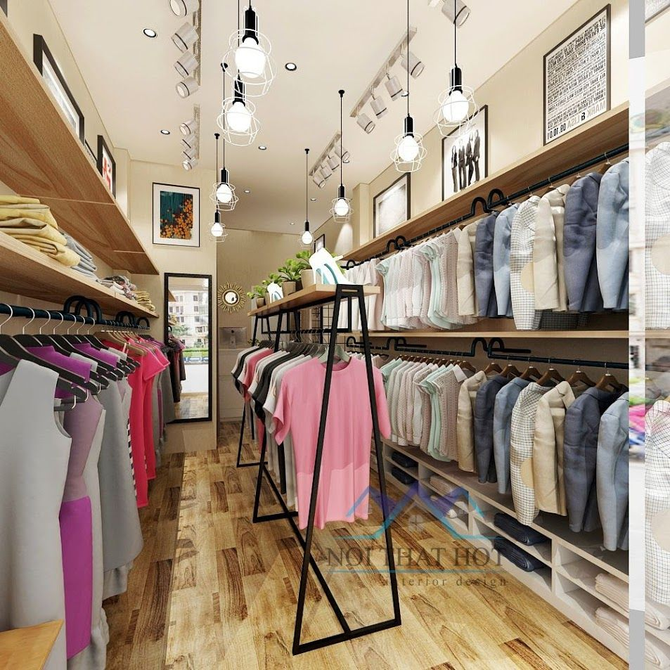
Introduction
The “Cloth store Management System” was developed to overcome the problems that prevail in the practical manual system. This software is supported to eliminate and, in some cases, reduce the difficulties encountered by this legacy system. Furthermore, this system is designed for the specific business needs to be implemented.
Smooth and efficient operation. The application is minimized to avoid data entry errors. It also provides an error message if invalid data is entered. No formal knowledge is required for the use of this system by the user. So, all of this proves that it is easy to use. The clothing store management system described above can result in an error free, safe, reliable and fast management system. It can help you focus on other tasks instead of focusing on keeping records. Big or small, every business face challenges and manages information on products, apparel, businesses, payments, and inventory.

Slide 5

DIGRAMS

Slide 6
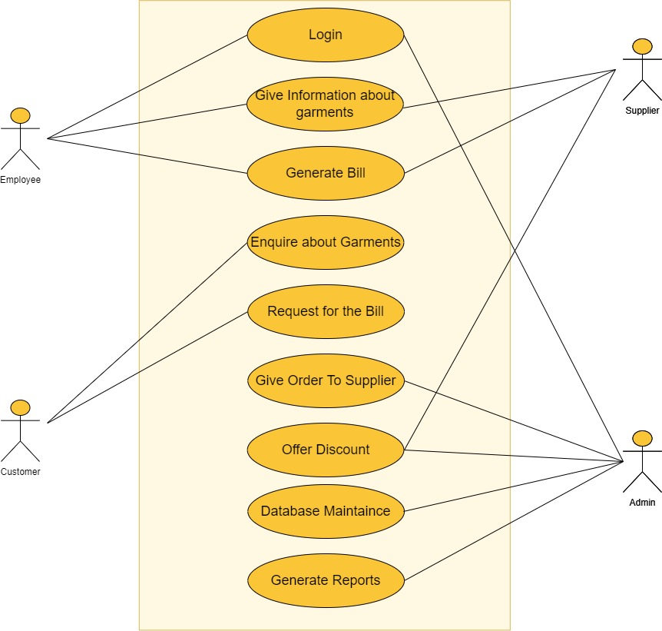
Usecase diagram

Slide 7
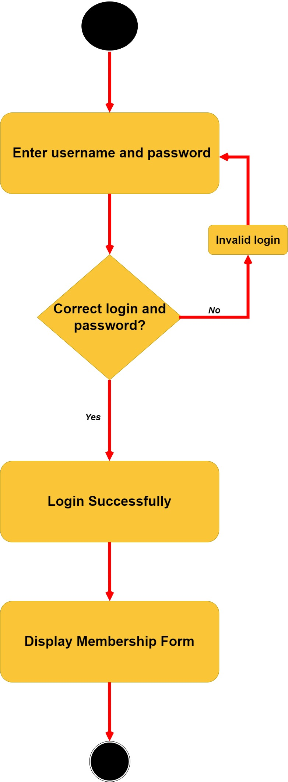
Activity diagram for login to the system

Slide 8
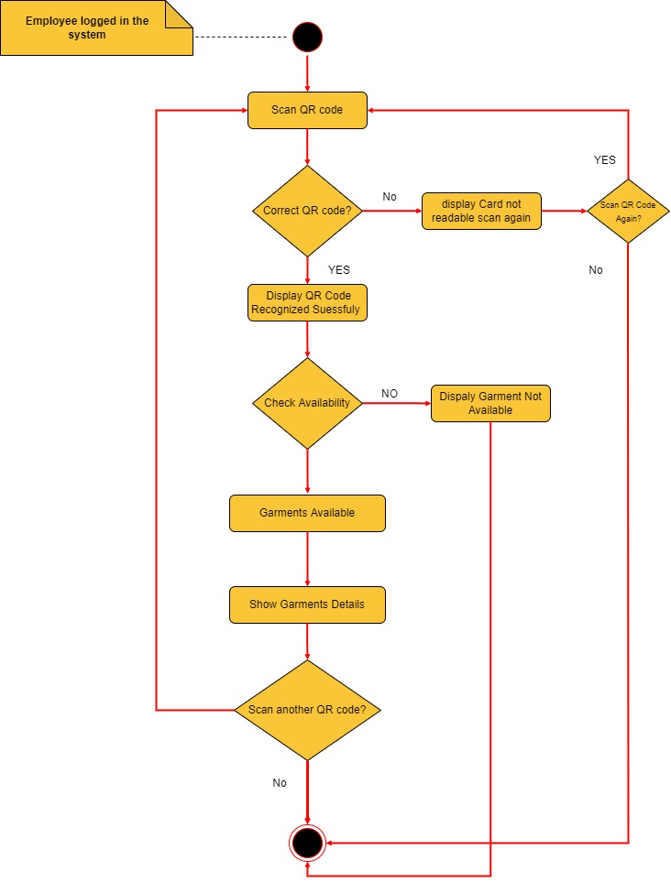
Activity diagram for garments information

Slide 9
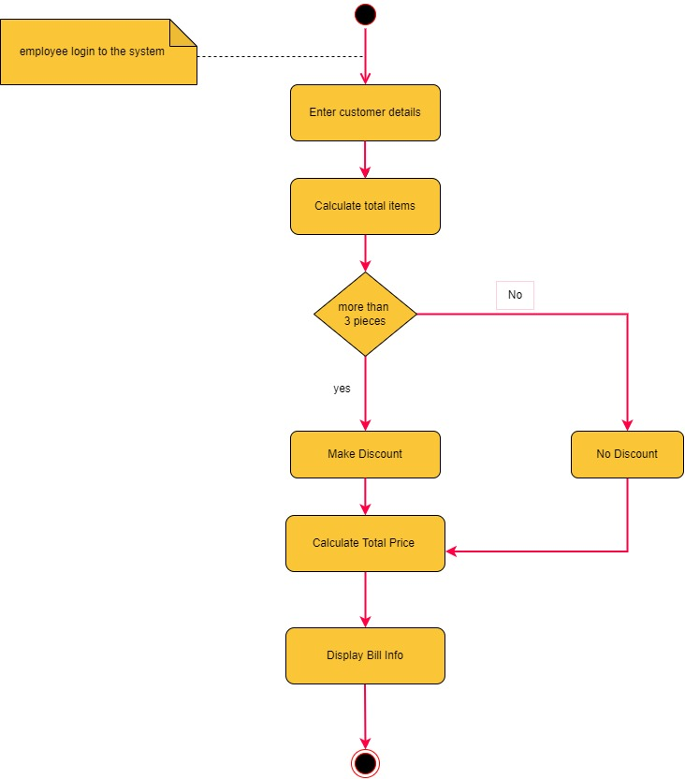
Activity diagram for generate bill

Slide 10
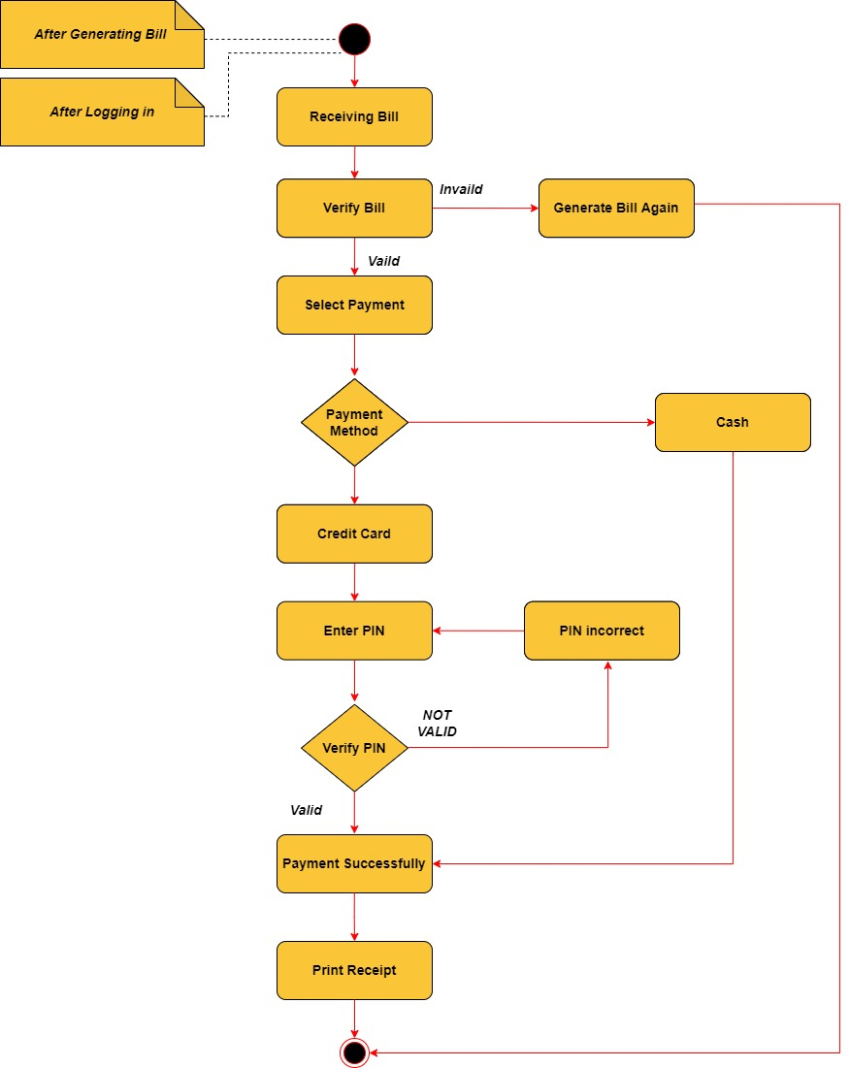
Activity diagram for request bill

Slide 11
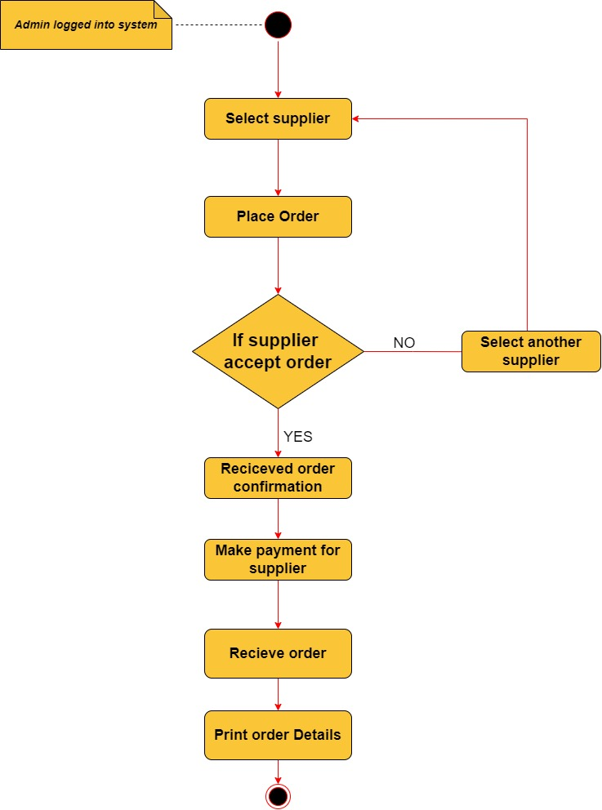
Activity diagram for give order to supplier

Slide 12
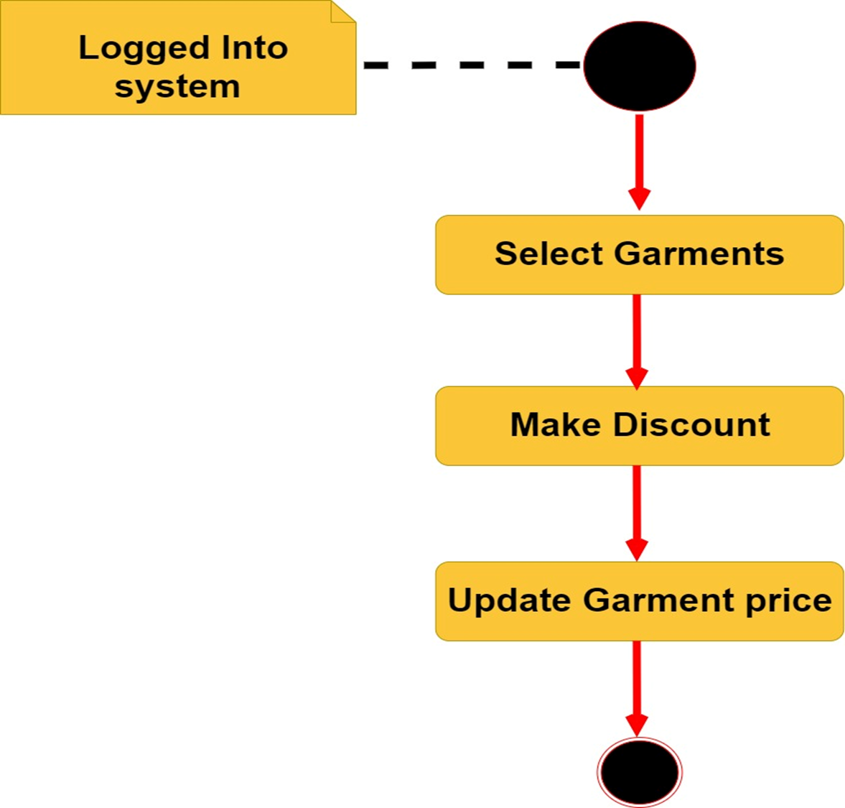
Activity diagram for offering discount

Slide 13
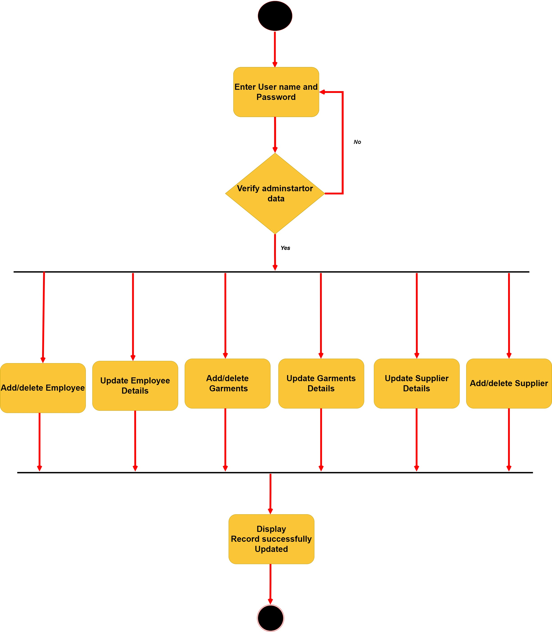
Activity diagram for database maintenance

Slide 14
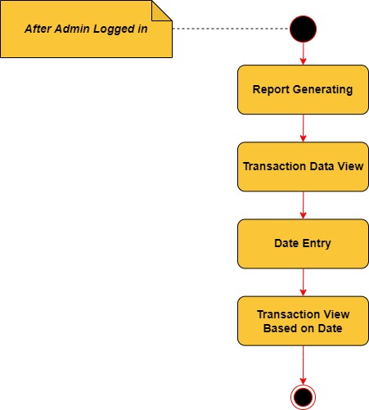
Activity diagram for generate report

Slide 15
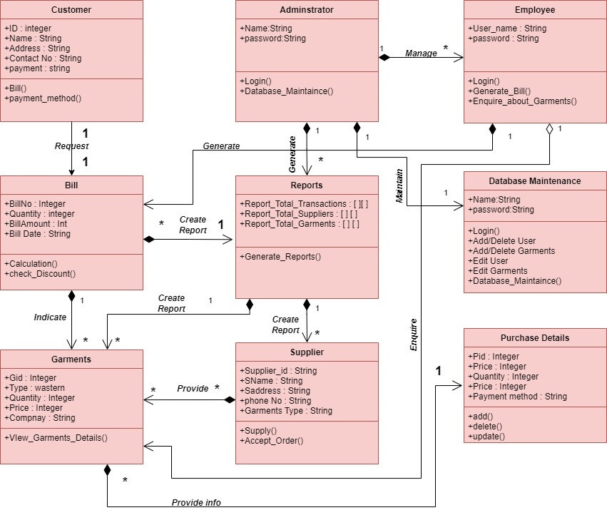
Class diagram

Slide 16
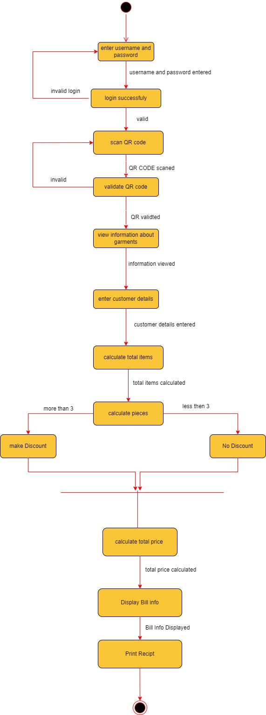
State diagram for employee

Slide 17
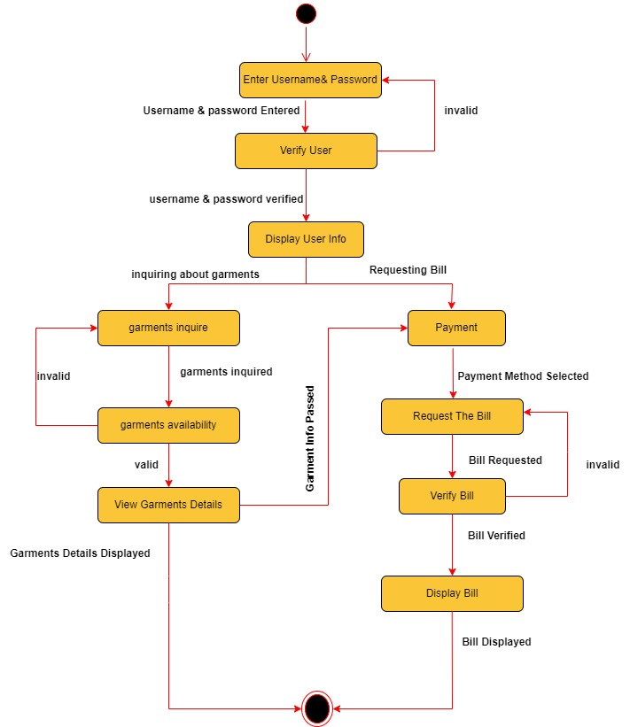
State diagram for customer

Slide 18
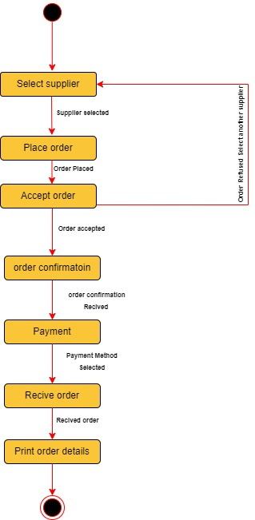
State diagram for supplier

Slide 19
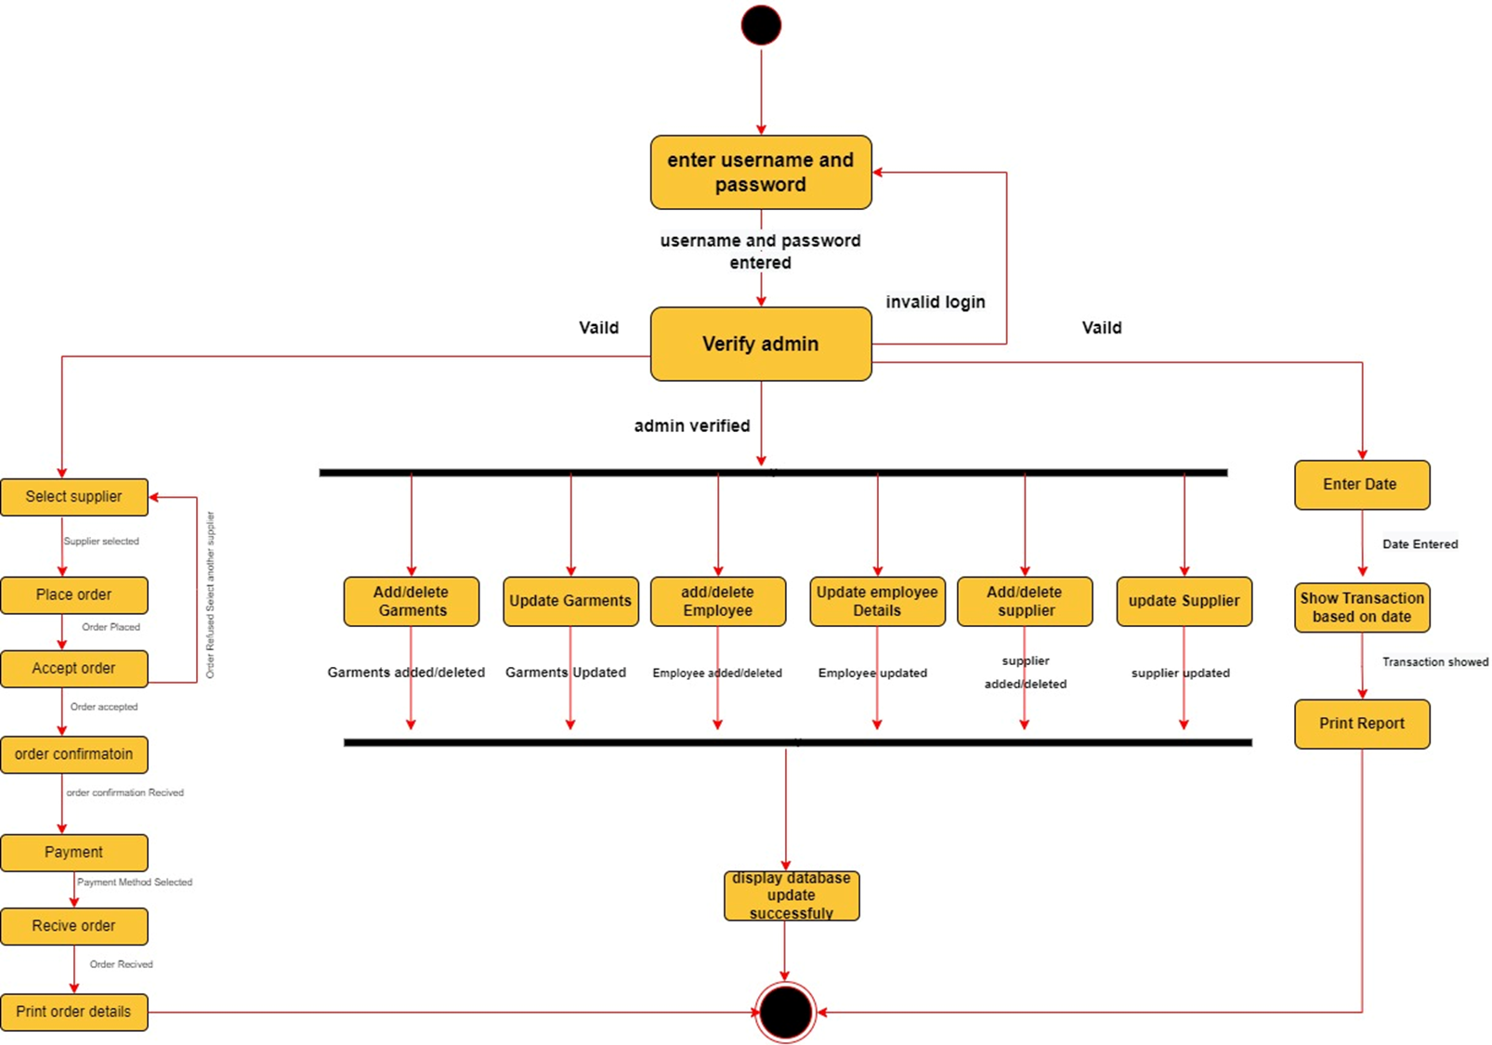
State diagram for admin

Slide 20
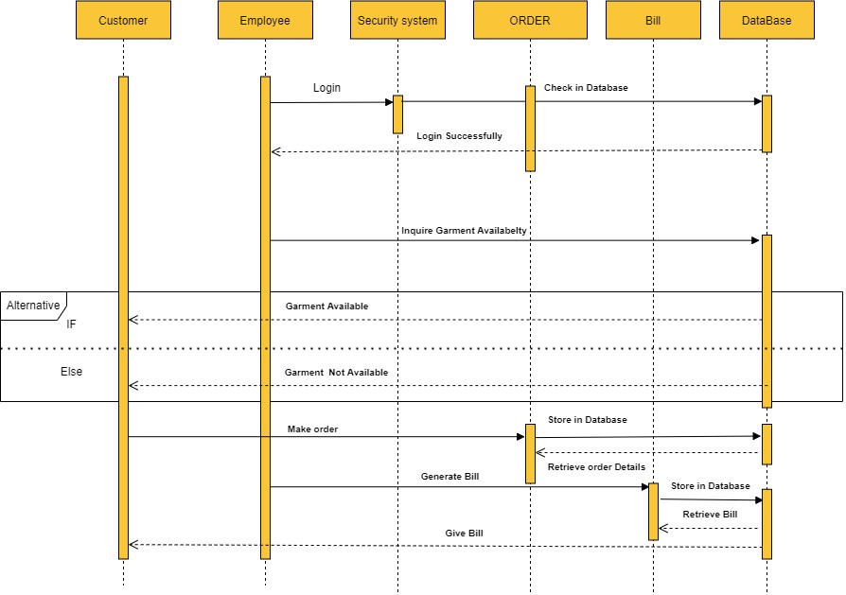
Sequence diagram for employee

Slide 21
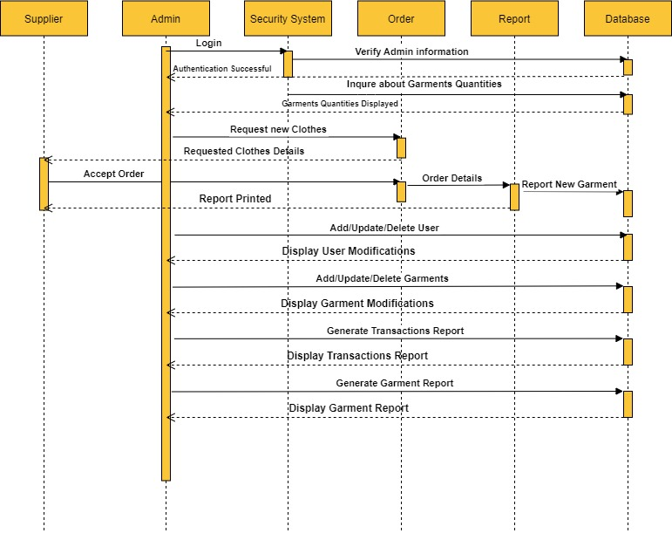
Sequence diagram for admin

Slide 22
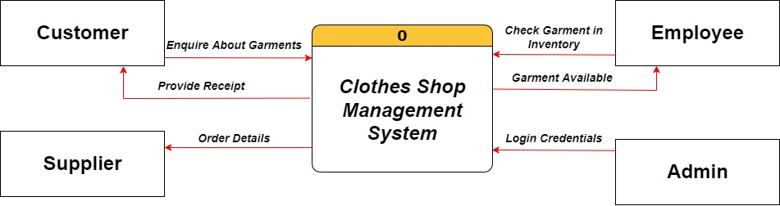
DFD diagram level(0)

Slide 23
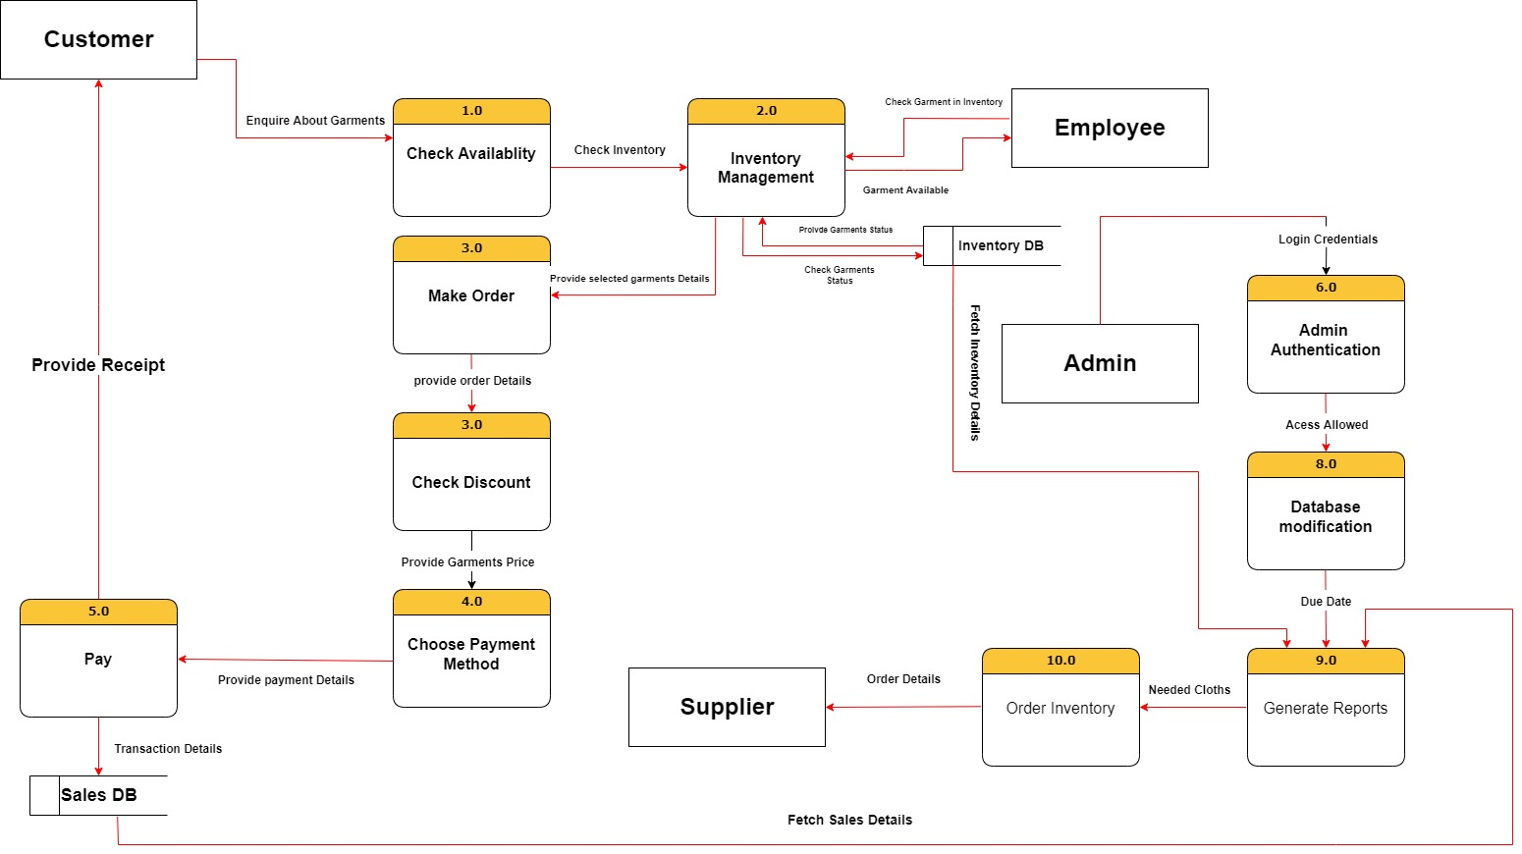
DFD level (1)

Slide 24
FRAMS

Slide 25
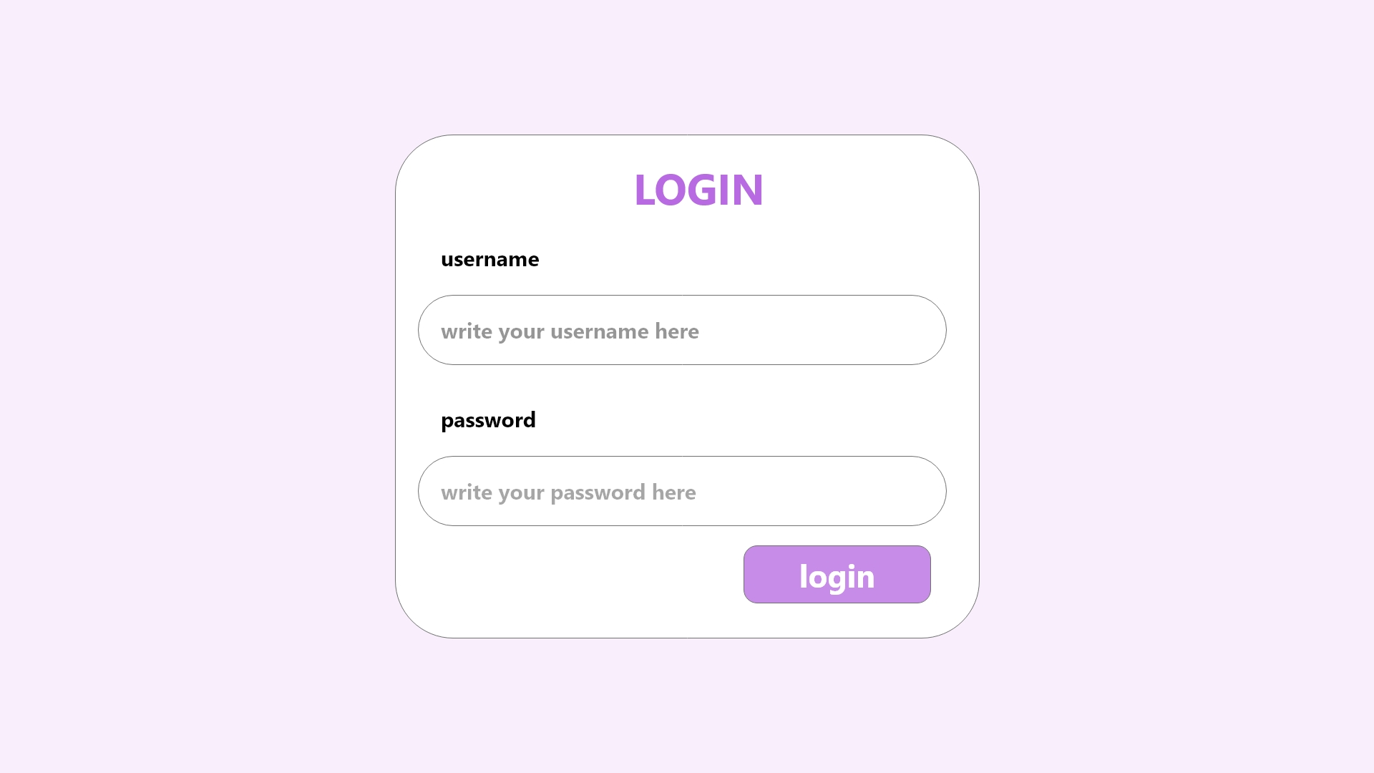

Slide 26
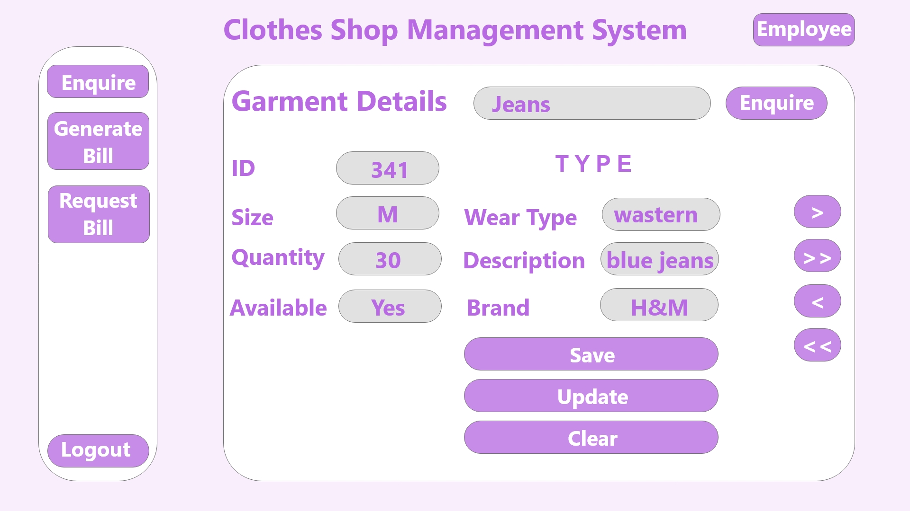
Employee FRAMS

Slide 27
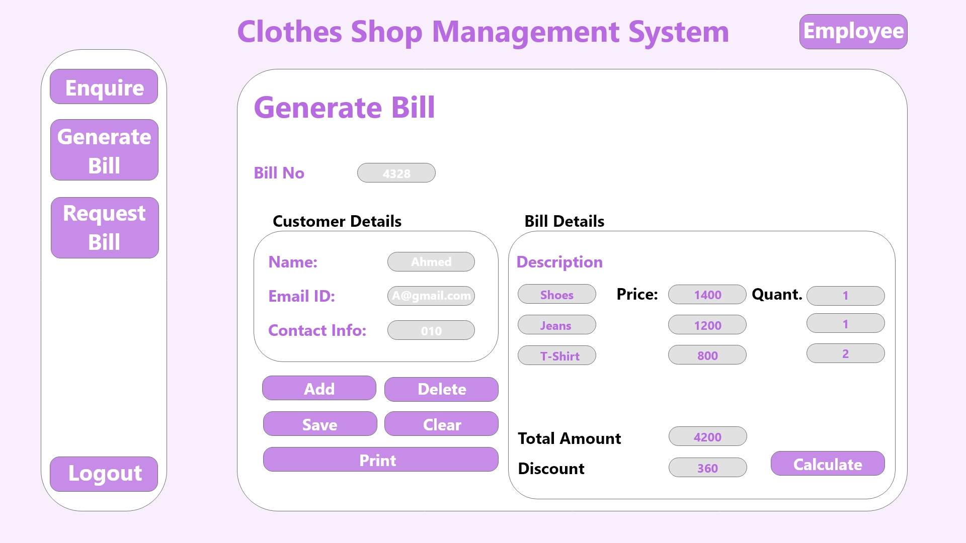

Slide 28
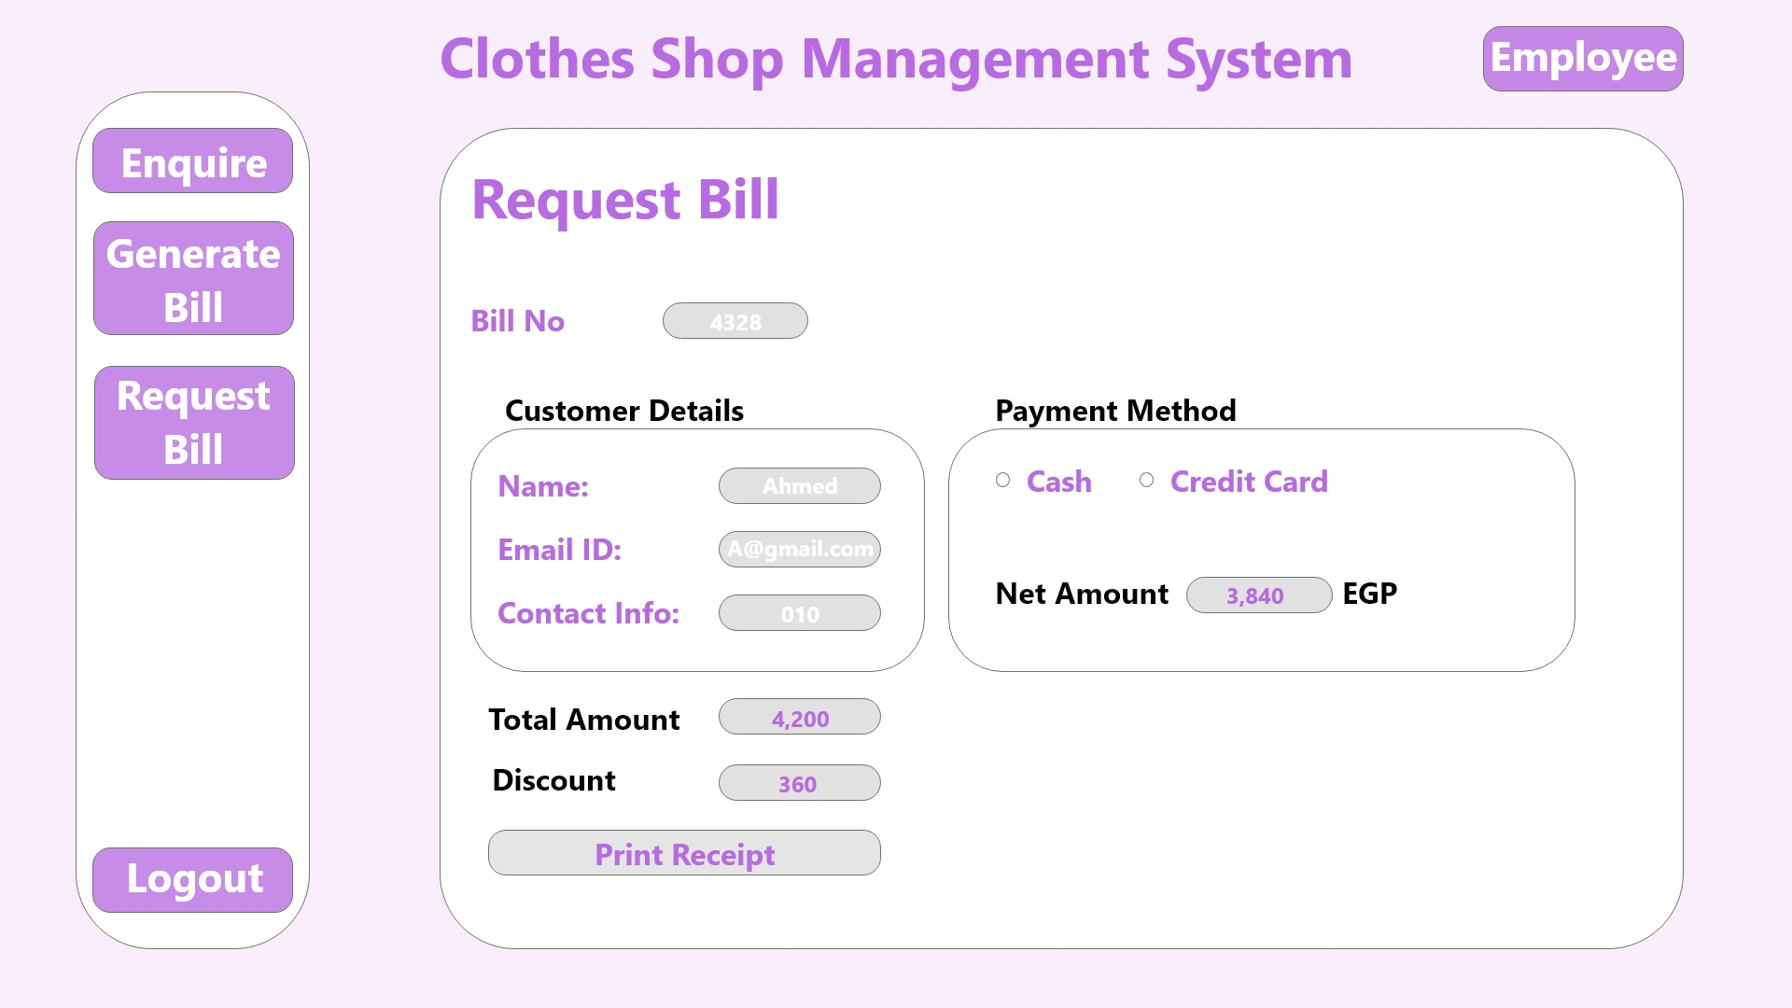

Slide 29
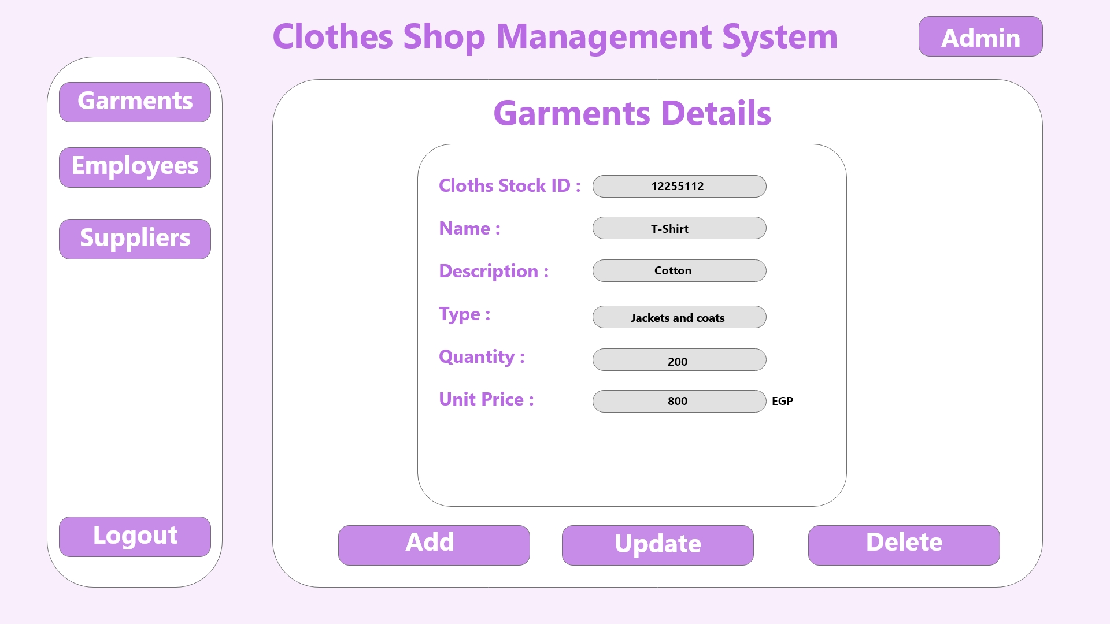
ADMIN FRAMS

Slide 30


Slide 31
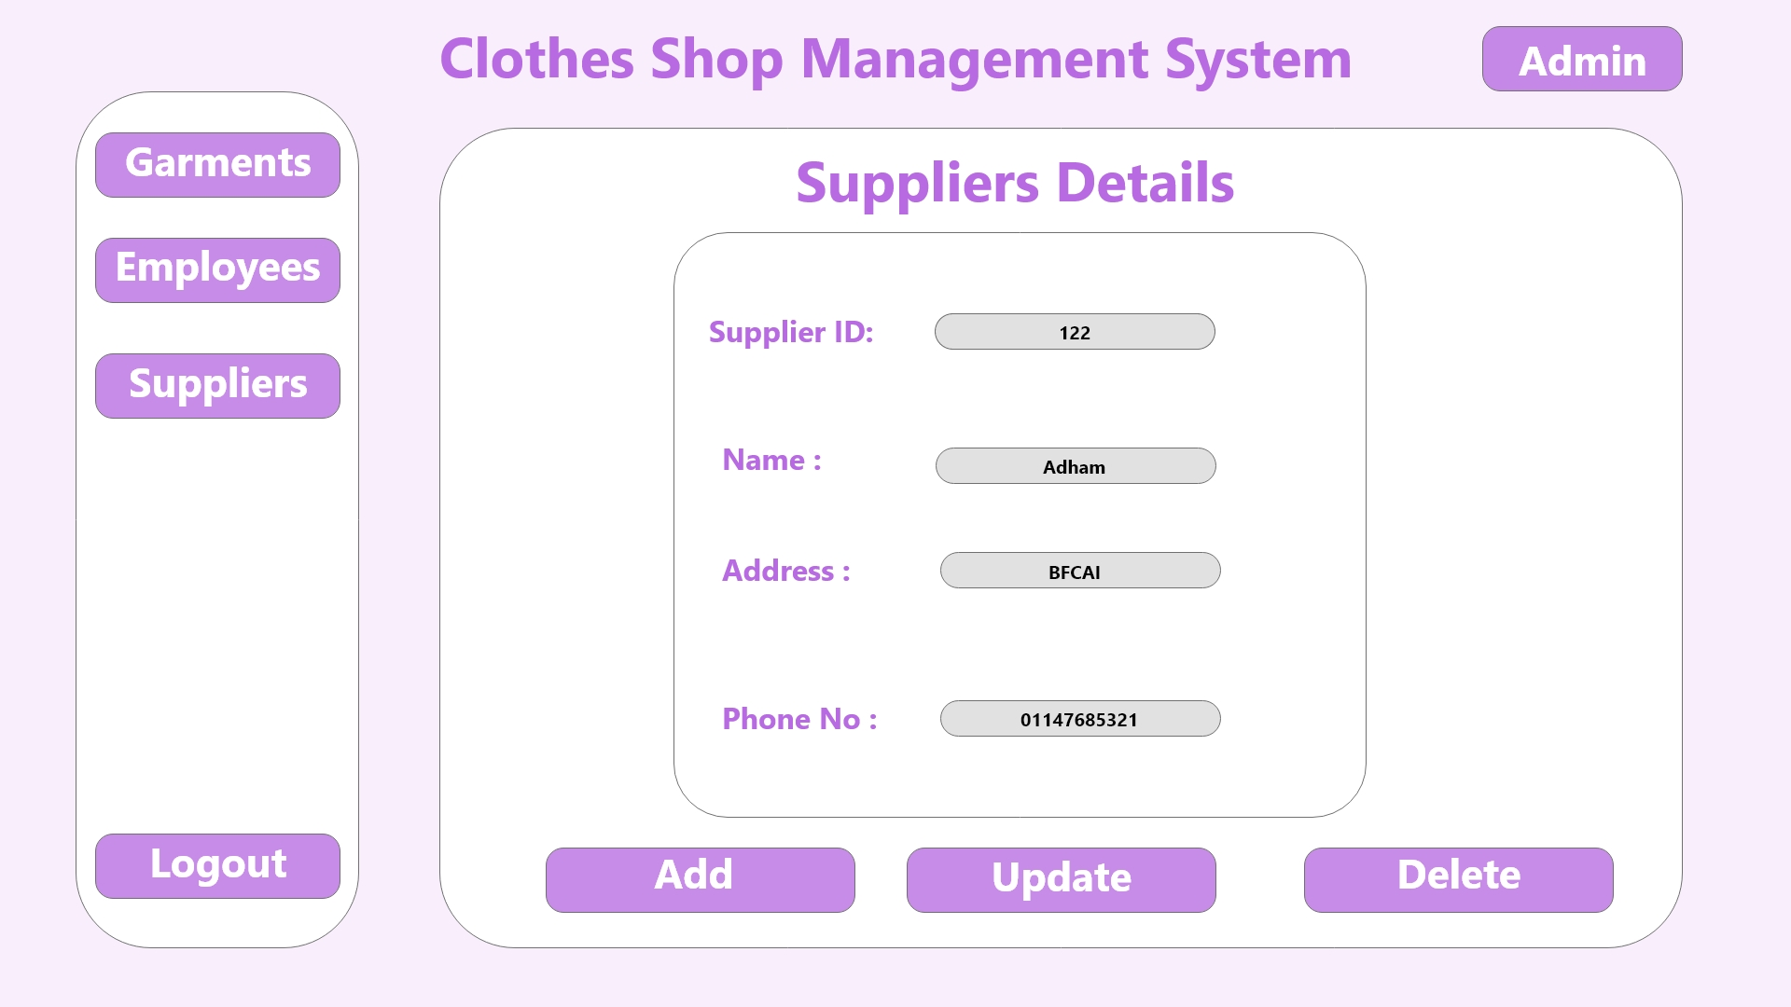

Slide 32
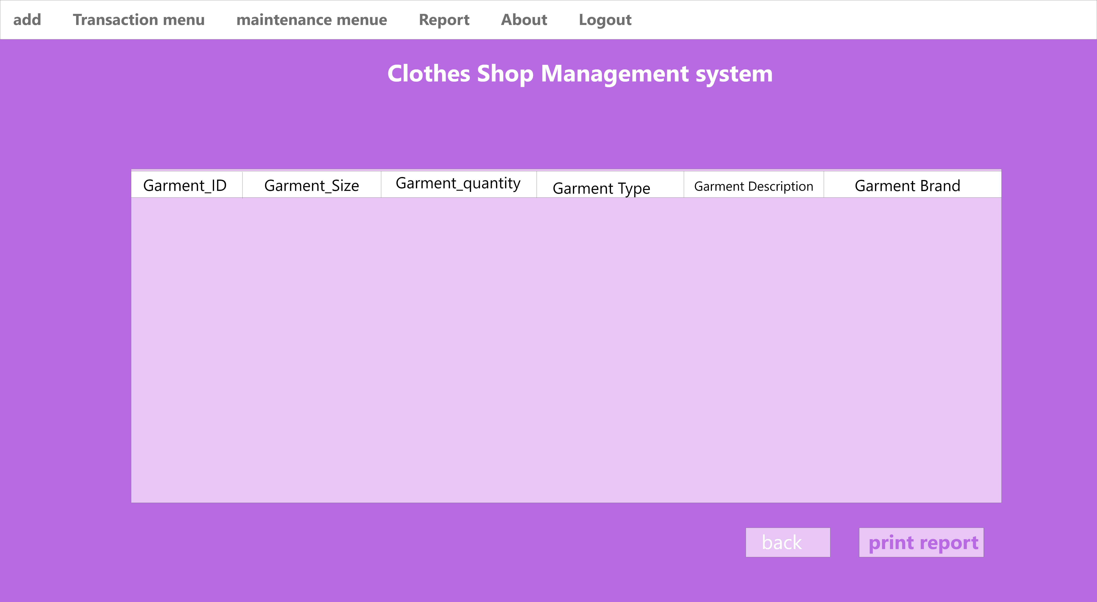

Slide 33
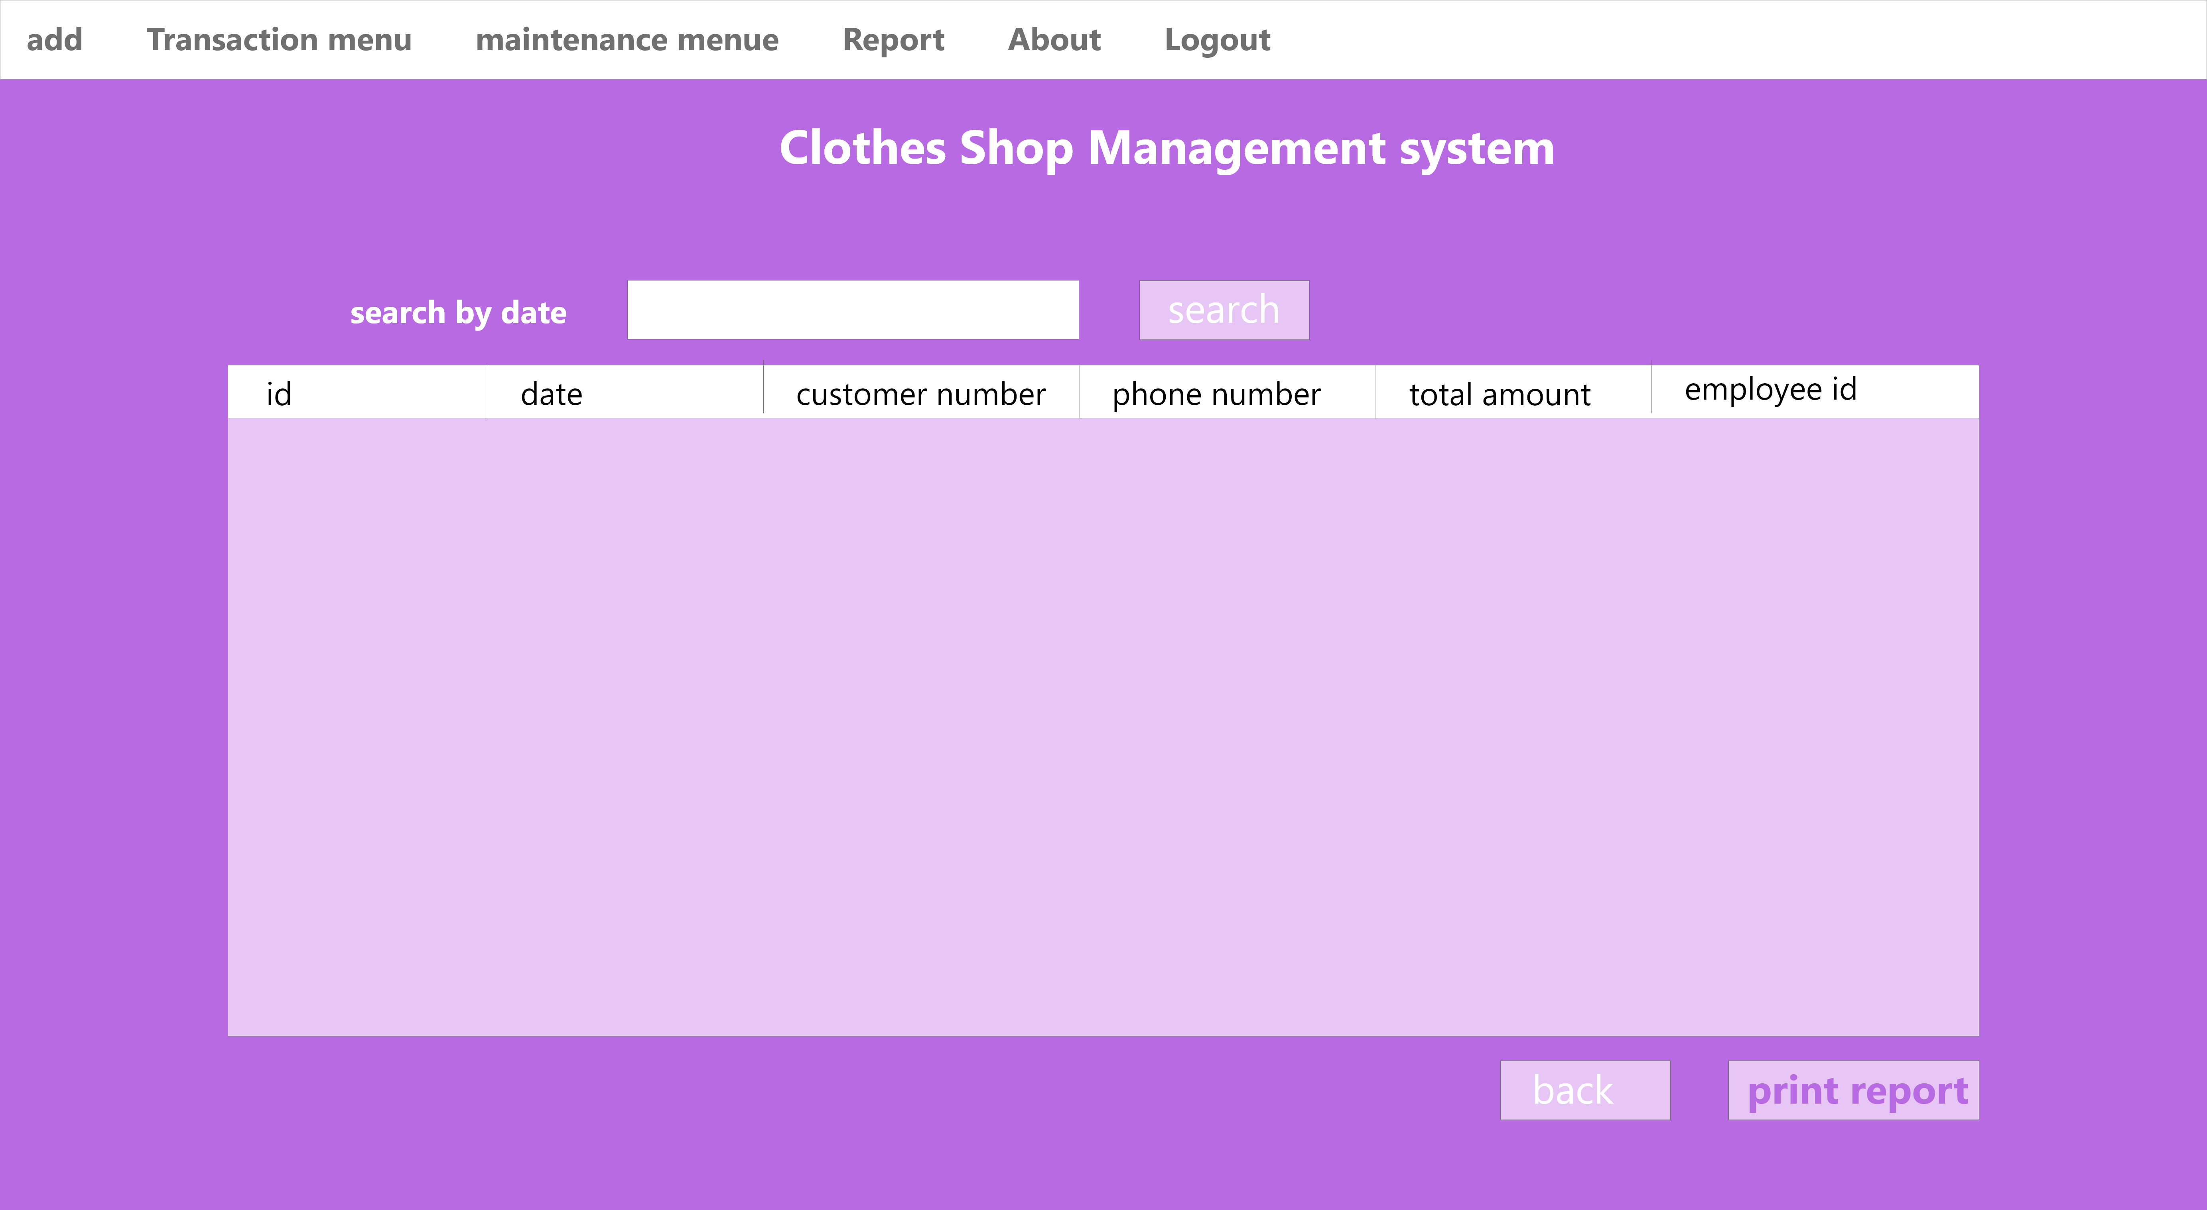
SUPPLIER FRAMS

Slide 34
